Slide 1
Reproducible quantitative proteomics analyses using Jupyter notebooks and R
Phillip Wilmarth
Proteomics Core, OHSU
2018 Cascadia Proteomics Symposium
Notes:
Hi. I would like to thank the organizers and to apologize for being an older white male.

Slide 2
Notes:
Quick question. How many of you are glad you are not up here right now? No worries – I am armed with a laser pointer!

Slide 3

Somers J. “The scientific paper is obsolete.” The Atlantic. 2018 Apr 5.
Notes:
I spent much of the winter creating notebooks to explain TMT data normalization and statistical testing. They are available on Github. Around the time the call for abstracts for this meeting went out, there was this Atlantic article. That made me think that a little tour of notebooks could be fun.

Slide 4
Atlantic article says notebooks can replace papers – so what are notebooks?
Notebooks are web server applications
You work on notebooks with web browsers
Notebooks format text, run code, and show output
Jupyter notebooks or R Markdown (RStudio) + knitr
Notes:
They are not electronic lab notebooks, nor are they like Evernote notebooks. The notebooks are like Mathematica notebooks and their newer open source variant Jupyter notebooks. So what are these kinds of notebooks? They are web server applications with some connection to a local programming environment. This is different than a typical web page, i.e. dynamic web content and javascript. You create and interact with notebooks through web browsers. Notebooks can render rich text formatting, execute code blocks (typically Python or R), and display the output (graphics more than text) from the code blocks. I will show you Jupyter notebooks today, but R Markdown in RStudio is conceptually very similar.

Slide 5
Installing Jupyter notebooks
Part of scientific python distributions
www.anaconda.com
Extensive documentation online
www.jupyter.org/documentation
Supports Python by default
R support needs separate installation
https//irkernel.github.io/installation/
Notes:
Before you can launch notebooks, you have to install the webserver application stuff. If you install a scientific Python distribution like Anaconda, you get Jupyter notebooks to go with numpy, matplotlib, pandas, scipy, scikit learn, etc. Scientific Python distributions have many packages that are not part of the standard Python library. Anaconda makes it easier to install al of these and keep them updated. Anaconda and all of the major packages including Jupyter notebooks have extensive online documentation. Python support is there by default; however, support for R takes some extra installation steps.

Slide 6
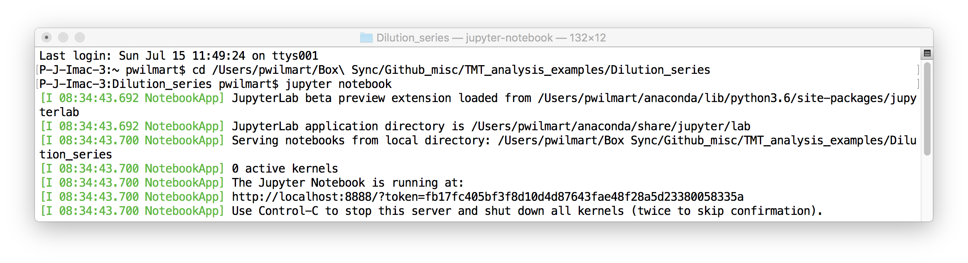
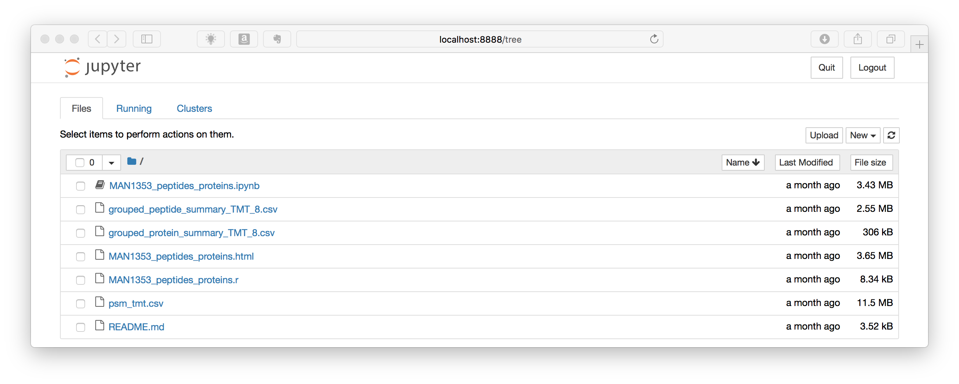
Launch Jupyter notebook from command line

Slide 7
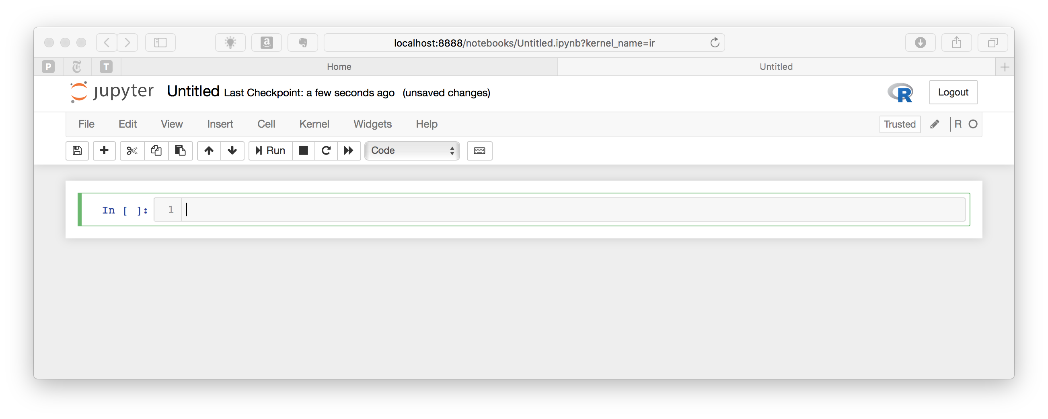
Notebook anatomy
Notebook name
Menu bar
Toolbar
Code cell
Multi-line with syntax highlighting
SHIFT + RETURN to execute
https://jupyter-notebook.readthedocs.io/en/stable/notebook.html

Slide 8
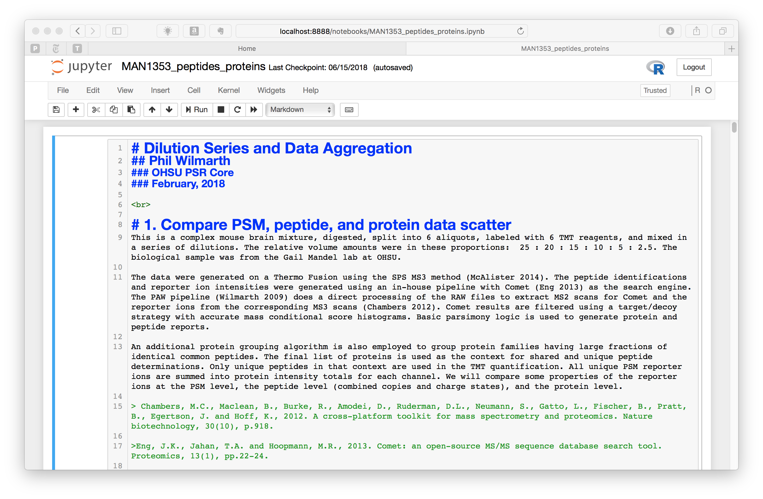
header levels
text
indented text
https://medium.com/ibm-data-science-experience/markdown-for-jupyter-notebooks-cheatsheet-386c05aeebed

Slide 9
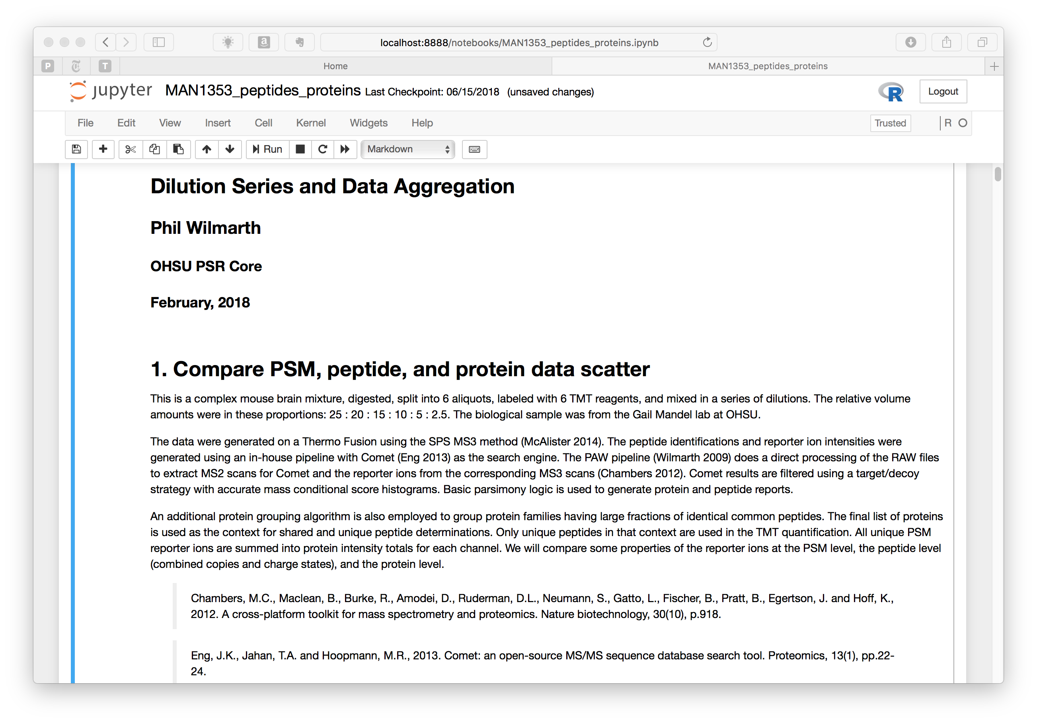

Slide 10
Notebooks are a linear collection of cells

Slide 11
Pictures are worth a thousand words
R and ggplot2 are very powerful for data visualization
TMT labeling of same digest in 6 dilutions
25 : 20 : 15 : 10 : 5 : 2.5
Comparisons at PSM, peptide, protein levels
https://github.com/pwilmart/TMT_analysis_examples

Slide 12
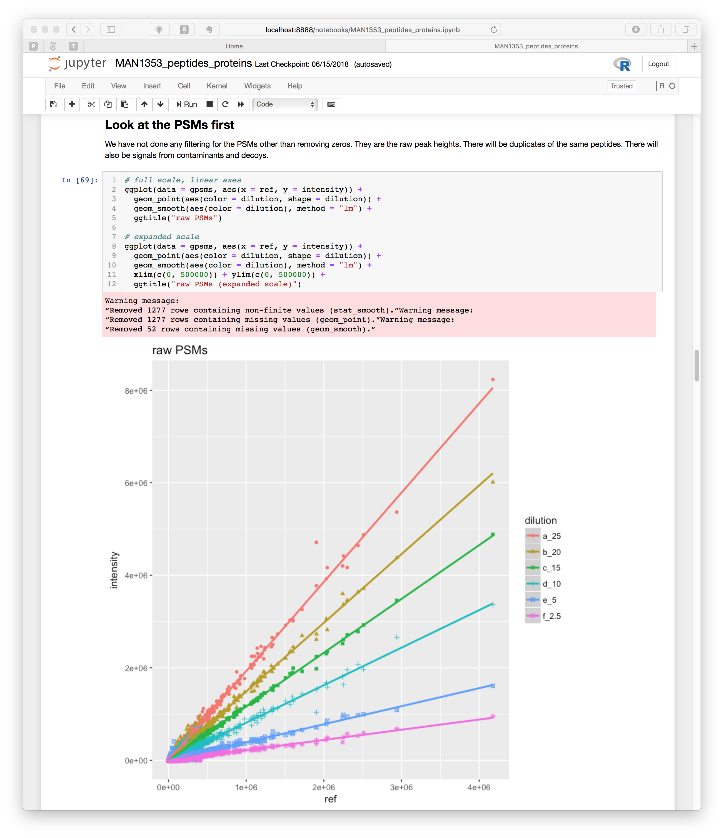
Markdown
Code
Output

Slide 15
MA Plot
Volcano Plot
Scatter Plot

Slide 16
Facet plots – separate candidates by significance
https://github.com/pwilmart/IRS_normalization

Slide 17
Without IRS
Mouse lens: 6 developmental times biological replicates in separate TMT experiments
Single factor normalizations seem to work
They don’t actually work
without IRS
with IRS
without IRS
with IRS

Slide 18
With IRS
Internal Reference Scaling: corrects random MS2 sampling that affects reporter ion intensities between scans.
Plubell, et al., MCP, 2017, v16, p873-890.
without IRS
with IRS
without IRS
with IRS

Slide 19
Without IRS
With IRS
without IRS
with IRS
without IRS
with IRS

Slide 20
Without IRS
With IRS
https://github.com/pwilmart/ASMS2018

Slide 21
Atlantic article says notebooks can replace traditional scientific papers…
Notebooks don’t work for all content
Notebooks make great Supplemental Materials
Notebooks are logical choices for:
QC and sanity checks
Normalizations, transformations, correlations
Statistical testing and modeling

Slide 22
Disclaimers
Scientific python and Jupyter notebooks are big topics
R is confusing and there is a lot to learn
Traditional (old) R
RStudio and modern R
Statistics
Bioconductor
Git/Github also extensive
“data science” field is interesting: Hadley Wickham, Wes McKinney, Jake VanderPlas (UW)

Slide 23
See: https://github.com/pwilmart
https://goo.gl/images/x2PZXP (Steve Macone, New Yorker, October 18th, 2010)

